Slide 1
Using the No Outsiders approach to teach the Equality Act (2010) in Primary Schools
Sue Bosley, Leicestershire Anti Bullying Team
Caroline Harbison, Leicestershire Anti Bullying Team
March 2022
Notes:
Intro and welcomes
Housekeeping
No Bystanders clip
5 mins

Slide 2
What messages are young people seeing and hearing about the world today?
(Insert some recent photos from local/current media eg, George Floyd/people wearing masks, etc.)
Notes:
Hate – discrimination – Armed police – Trump’s administration
Edward Colston statue in Bristol
Basically, messages kids are getting through media, locality issues and world problems. They’re arriving at school with fear and confusion and how are we talking to kids about this…are we even talking to them at all?
Media, social media enhancing kids awareness of these themes.
Ghandi statue – storming of Golden Temple in India – hundreds of Sikhs killed in retaliation
Westminster Bridge – March 2017
A 6,000 name petition is calling for the sculpture of the Indian leader and civil rights campaigner to be taken down from the plinth in Belgrave Road where it has stood since 2009.
The petition was launched after a statue of Bristol slaver Edward Colston was toppled during a recent Black Lives Matters protest and dumped in the city’s harbour.
The organisers of the Gandhi statue petition said he was a "fascist, racist and sexual predator" who brought "inconsolable suffering" to millions of people during the partition of India before his assassination in January 1948.
That has enraged many people from the Indian community in Leicester East.
calls to take down the statue of Mahatma Gandhi in Leicester are a distraction from this crucial movement.
“I recognise that, like many people of his era, Gandhi said and did some questionable things in his life. Yet Gandhi was part of creating a historical anti-imperialist movement in the same way that Martin Luther King created a ground-breaking civil rights movement.
"His form of peaceful protest, like Black Lives Matter today, was a powerful force for change.
“The difference between a statue of Gandhi and statues of slavers such as Edward Colston, is that there is no reasonable debate that Colston – who derived his wealth from the murderous slave trade – is a morally defensible figure to be memorialised.
“The same cannot be said for Gandhi, who remains a hero to many of Leicester’s Asian community and to millions across the world.” (Leicester East MP Claudia Webbe)
Edward Colston Statue - Bristol

Slide 3
Life in 2020 for children and young people
The number of hate crimes reported to police has more than doubled since 2013
There have been spikes in hate crime following certain events such as the EU referendum and the terrorist attacks in 2017.
15.10.19
Notes:
Keep format of slide but update info

Slide 4
Radical ideas coming into school?
Hate Crimes In Schools Rise By 121% In Just Three Years
12.09.19
Police reports of hate crimes in schools rose by 89% in May 2016 compared to May 2015 (post Brexit referendum)
Between September 2015 - July 2016 and September 2016 - July 2017, the number of crimes and incidents with a hate element in schools rose by 38% .
Notes:
What is happening ‘out there’ is coming into our schools and our classrooms
UPDATE slides see links in TEAMs chat

Slide 5
Hate crime linked to schools in England and Wales soars
Data from all of the UK's police forces have shown there were 900 hate-related incidents in schools in 2015, meaning on average there were five a day.
But that figure rose to 1,987 in 2018, an increase of 121 per cent.
Rise in the number of hate crimes related to religion or beliefs, sexual orientation, and disability or transgender identity.
12.09.19
Home Office figures show surge in offences linked to sexual orientation and trans identity
Data from 29 police forces in England and Wales shows a rise in the number of hate crimes related to religion or beliefs, sexual orientation, and disability or transgender identity.
Notes:
5 mins (inc previous 4 slides)

Slide 6
Radical ideas coming into school?
Reports a pupil suffered five years of "harrowing" racist abuse at a Leicestershire school are being investigated by police after they appeared on social media
June 2020
https://www.youtube.com/watch?v=gmk1FR1cUzA
Tristram Hunt, election campaign 2015
Notes:
What is happening ‘out there’ is coming into our schools and our classrooms

Slide 7
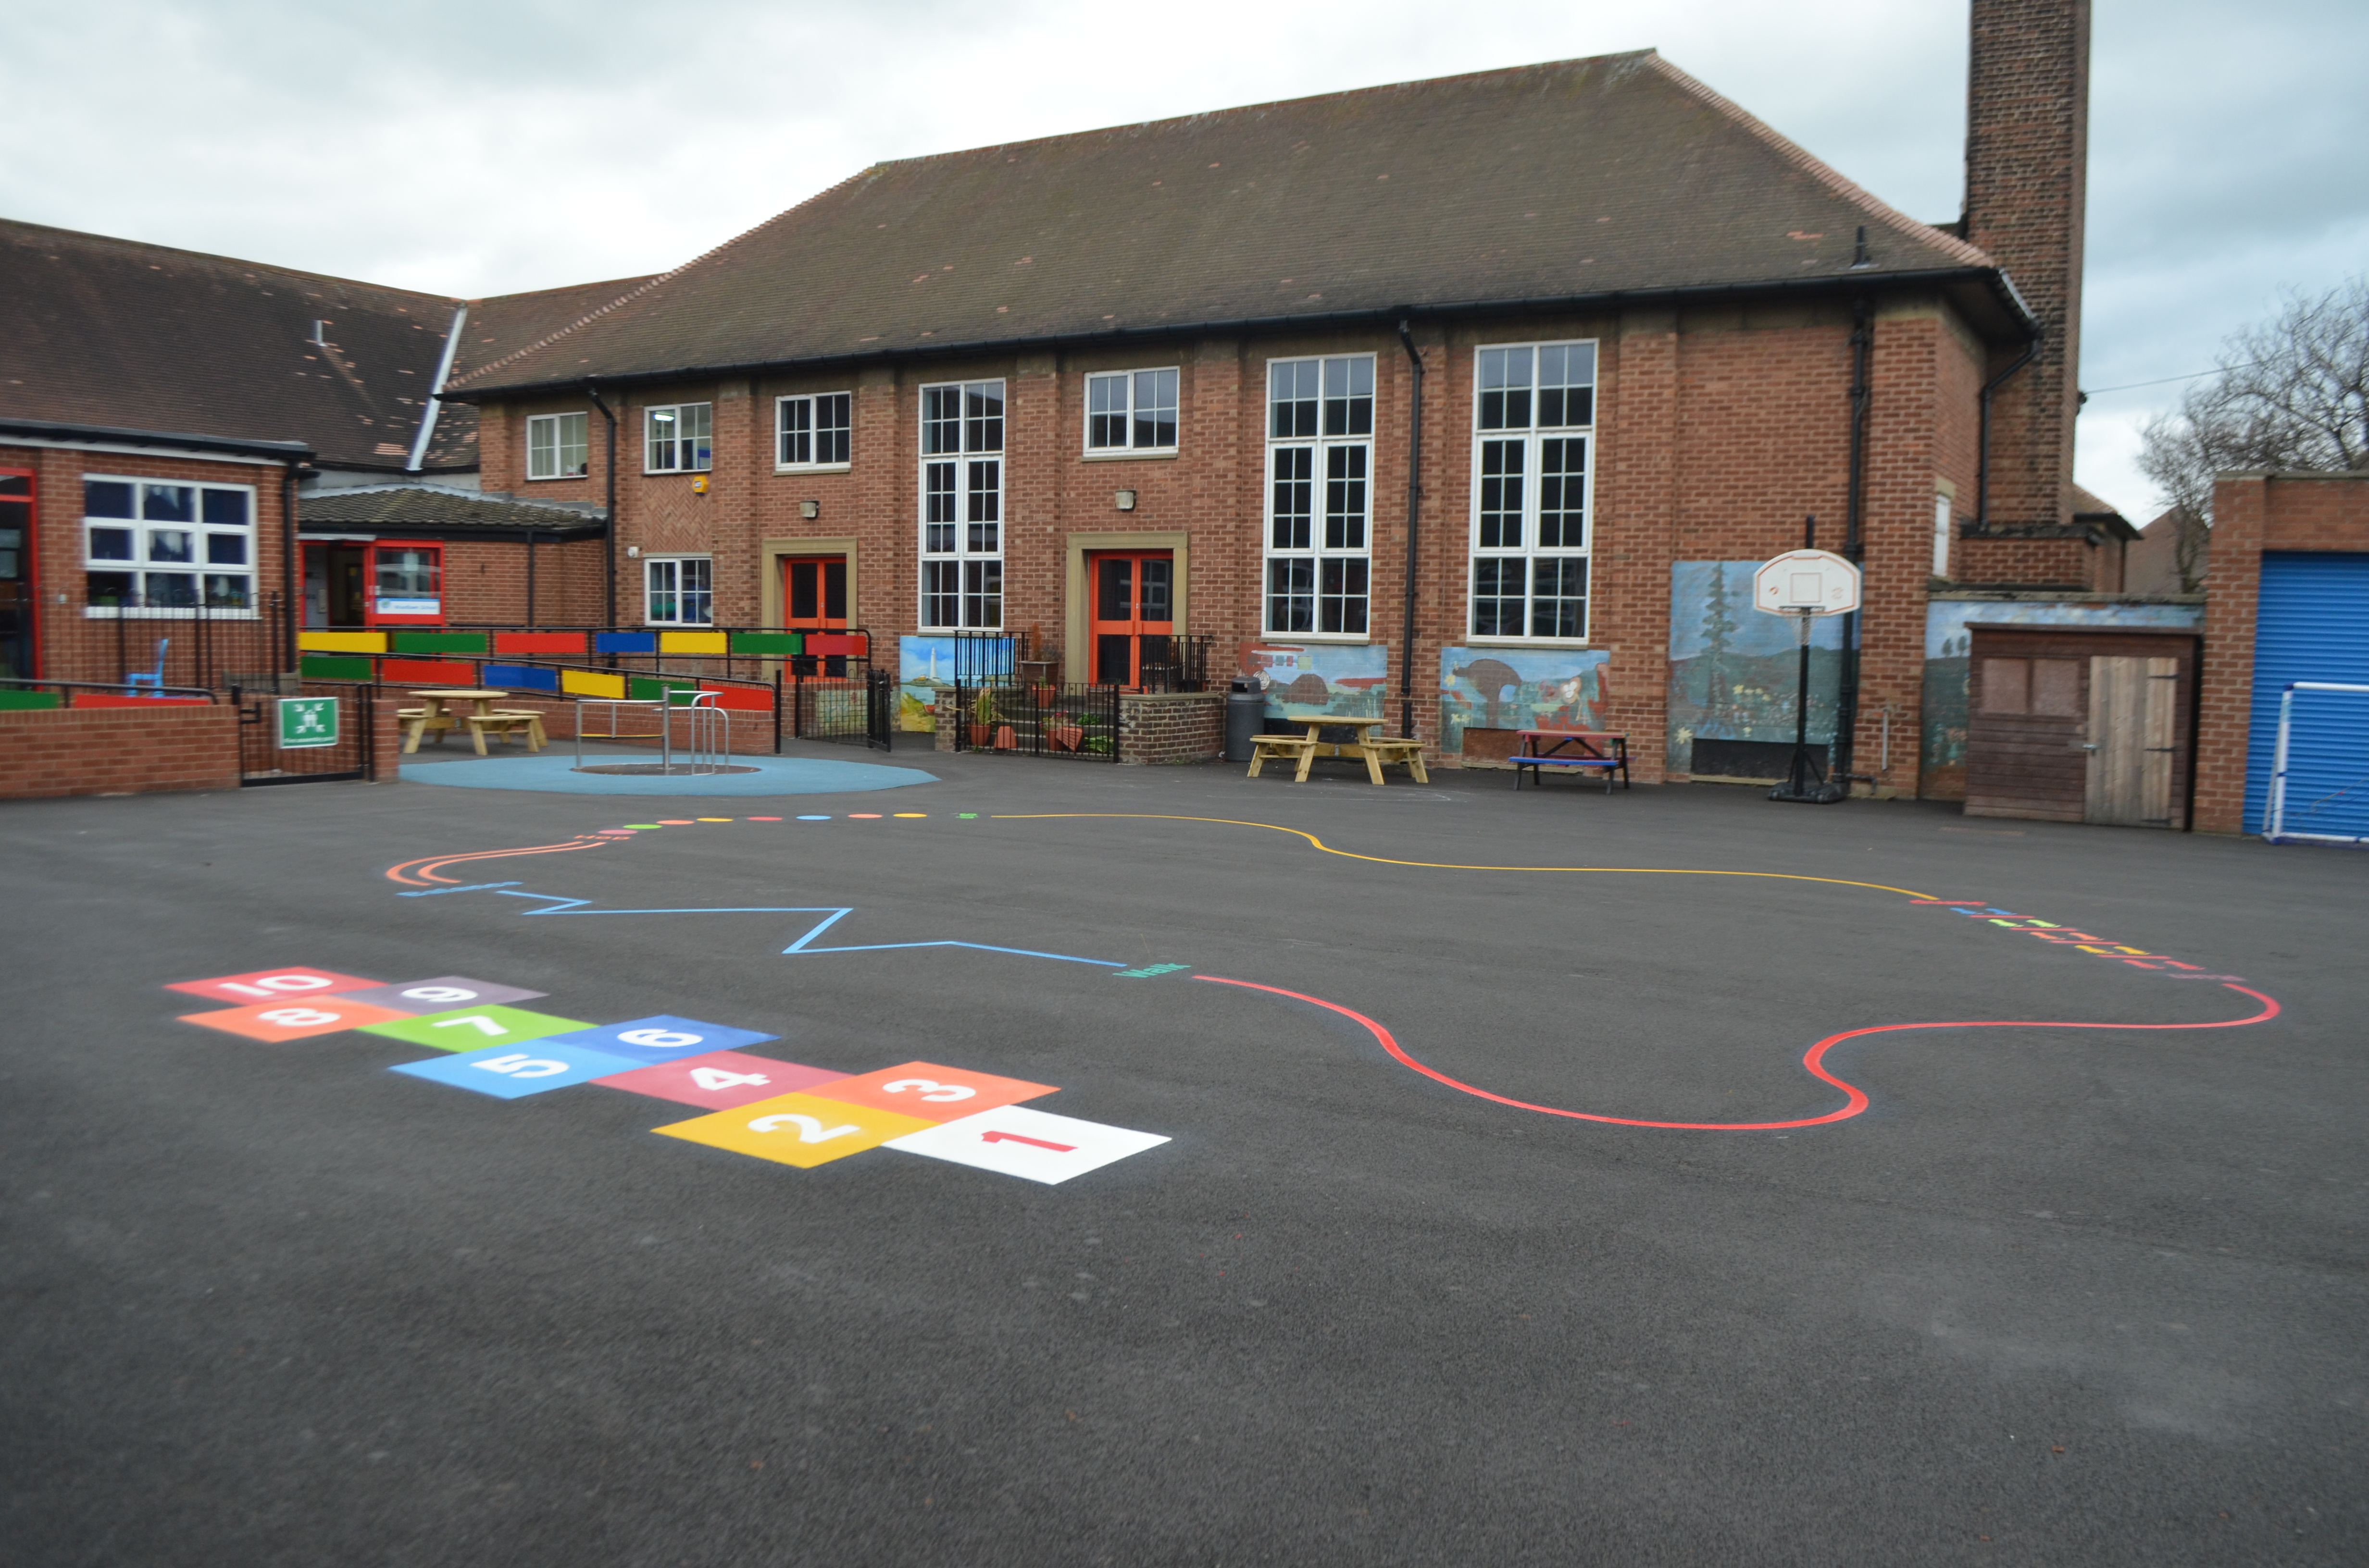
Who is providing answers to children?
Notes:
Link back to Tristam Hunt clip – what if the boy goes onto youtube and types in get foreigners out?
So important that staff in schools have input, can discuss and debate, provide balanced views, offer alternative points of view – so important for this work to be done
6 mins

Slide 8
An alternative narrative?
“We have to be delivering a curriculum that enables children to understand the benefits that exist in a society where diversity and difference are celebrated. Furthermore we need our children to want to be part of that society, and we have to sell it to them; that desire may not come naturally by itself.”
Notes:
Or from home….
No Outsiders is the mouthpiece to do just this…challenge hate and discrimination and acceptance.

Slide 9
What if my school isn’t diverse?
Different Languages
Different Ethnicities
SEN
Gender
Different Families
Sexual Orientation
Tomatoes
Chocolate
Notes:
Talking activity – How diverse and how is your school diverse? List the ways
Not all about the big issues but the individual characteristics of our kids.
10 mins

Slide 10
Activity
Ethnicity
Language
Religion
Sexual Orientation and Gender Identity
SEND
Notes:
Think of as many examples in your heading

Slide 11
Who are our children/families?

Slide 12
White: Irish
Semantic Pragmatic Disorder
Hearing Impairment
Mixed: White and Black African
Asian or Asian British: Other Asian
Slovak
White: British
Jewish
Asexual
ASD
Cisgender
Downs Syndrome
Gay
Lesbian
Language Impairment
Gujarati
English
Asian or Asian British: Chinese
Mixed: White and Black Caribbean
Epilepsy
Christian
Dyspraxia
Persian
White: Gypsy or Irish Traveller
Urdu
Transexual
Visual Impairment
Trans Woman
Trans Man
French
Communication and interaction
Somali
Man
Black or Black British: Other Black
Asian or Asian British: Pakistani
Tamil
Sensory difficulties
No religion
Hindu
Crossdresser
Asian or Asian British: Bangladeshi
Polish
White: Other
Shona
Intersex
Greek
Muslim
Gender-Variant
Language Delay
Mixed: White and Asian
Non binary
Gender fluid
Turkish
Sikh
ADHD
Behaviour, emotion and social difficulties
Hindi
Swahili/Kiswahili
Physical Difficulties
Bengali
Black or Black British: Caribbean
Woman
Arabic
Tagalog/Filipino
Buddhist
Black or Black British: African
Punjabi
Kurdish
Asian or Asian British: Indian
Bisexual
Specific Learning Difficulties
Questioning
Portuguese
Straight
Cognition/learning difficulties
Aspergers
Mutism
Multi sensory impairment
Notes:
What does this indicate to us about our potential clients/service users?
They are incredibly varied and diverse and how do we ensure we are open and welcoming to all individuals whatever their identity, culture, special needs etc.? And if we are, how do we show the community we are?
Before we answer these questions, want to talk a bit about why we have to ensure we are….

Slide 13
The Equality Act 2010
The Equality Act (2010) protects individuals from discrimination in the workplace as employees and in wider society as service users. It covers these protected characteristics:
Age
Special Needs and Disability
Marriage and Civil Partnership
Gender reassignment
Pregnancy or maternity
Religion or belief
Race
Sexual orientation
Sex

Slide 14
The Equality Act (2010)
Section 149 of the Equality Act sets out the Public Sector Equality Duty
The Public Sector Equality Duty requires that public bodies:
Eliminate discrimination
Advance equality
Foster good relations

Slide 15
The Law
Illegal to ignore aspects of the Equality Act.
So we cannot promote an ethos where people of diverse faith or age are welcome but those of diverse sexual orientation or ability are not.
Preparing children for the world and workplace beyond school
Notes:
What is clear here, is that public bodies (including schools and academies) paying regard to some of the protected characteristics of the Act and not to others, is simply against the law.
So we cannot promote an ethos where people of diverse faith or age are welcome but those of diverse sexual orientation or ability are not.
Similarly, children need to be taught this fundamental value within the law, as when they leave school and get a job, they will not stay employed for long if they are not respectful of all individuals in the workplace.

Slide 16
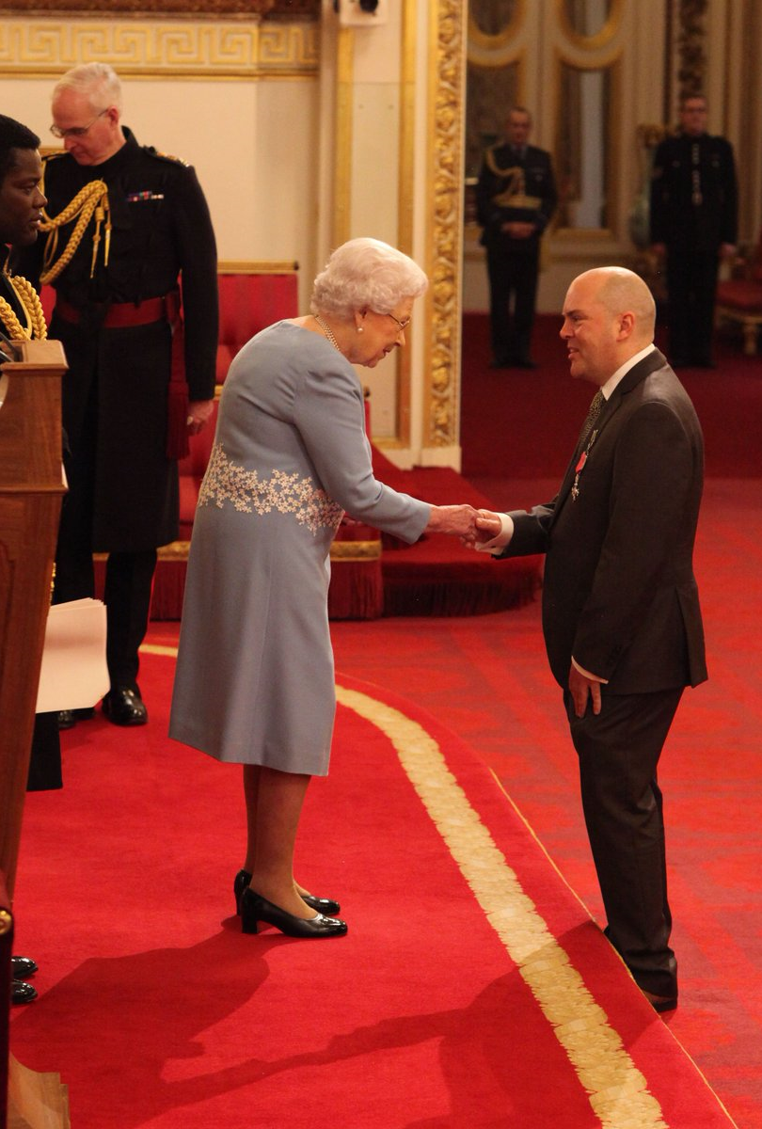
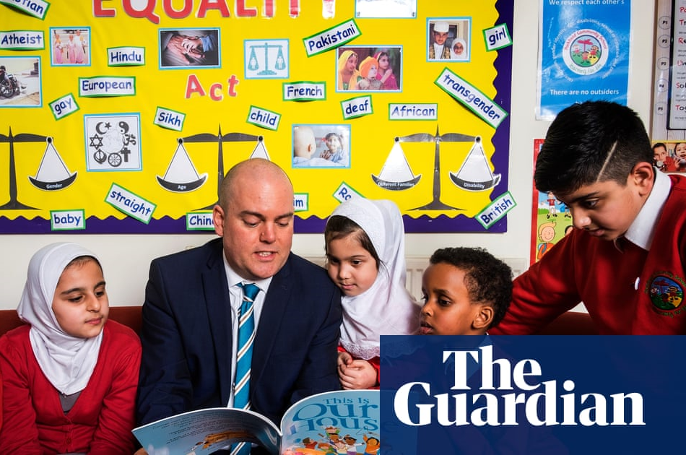
Andy’s Story
Notes:
Unlikely parents will be worried about your school teaching children that people in our community are differently labelled. Never had parents complain about lessons where we teach about sexism or stereotypes or that talk about people of different ages. What will bring around some discomfort for some parents, is challenging homophobia. Parents may believe their children are too young to learn about sexual orientation or may be aligned to a faith that identifies homosexuality as a lifestyle choice that is unacceptable.
Many schools will do work around LGBT issues without challenge or question and many are doing it successfully already. But…some schools for a variety of reasons may face challenges.
2014
No Outsiders resource piloted by Andrew Moffat in his own school.
2015
’No Outsiders in Our School’ resource is first published
2016
Andrew's school receives 'outstanding' Ofsted report, No Outsiders highlighted as a key strength.
2017
Andrew awarded MBE for his work in equality and diversity in education.
"Reclaiming radical ideas in schools: preparing young children for life in modern Britain" is published, providing lesson plans for parent No Outsiders workshops.
2018
No Outsiders reputation spreads via word of mouth, used in schools across the UK.
2019
Andrew listed as a top 10 finalist in the Varkey Foundation Global Teacher prize 2019.
Media attention on No Outsiders increases demand for educational resources, training and support in delivering equality lessons.
No Outsiders launched as a registered charity.
Andrew listed in Attitude Pride Awards; awarded Pink News Role Model of the Year and named Hero of the year in the European Diversity Awards.
University of Worcester awards Andrew Honorary Doctorate.
2020
Andrew begins new role as PD (Personal Development ) Lead at Excelsior Trust.
Sunderland University appoints Andrew as ‘Visiting Professor’.
During lockdown Andrew writes new resource “Agents of hope: Teaching mental health and well being after lockdown” which is made freely available on the Excelsior website.
May-July Andrew provides weekly ’Agents of hope‘ newsletters for schools with free lesson plans snd assembly plans

Slide 17
Lessons learned from two schools
Parental engagement is key
Transparency
Whole school ethos
Preparing your path
Notes:
Vital to have parents informed and curriculum must not be a surprise to them. They must see and read the books and have the ethos explained to them – this is not sex education, rather it is about promoting difference and diversity.
Everyone must know this is happening and everyone must be signed up and delivering the key messages
Vital to have governor support from the beginning – back up. Head must be leading and modelling the ethos from the top down. The work must be part of a while school ethos. All members of staff must be doing the work – we can’t have children receiving mixed messages.
Outside school, teachers may hold different personal views that cert is wrong….but a part of a teachers job today is to uphold British Values and British Law. And British Law says a person cannot discriminate because of race, religion, gender identity, age, disability or sexual orientation. Further more, schools as public bodies must promote diversity and celebrate difference.

Slide 18
Where are we now?
Compulsory RSE
Andy –take up, charity, role in his Academy Trust, new book
Successful in Leicestershire Schools
Ongoing demand
Notes:
Check no of County schools.

Slide 19
Ofsted (May 2019)
Key Judgements
Behaviour and attitudes
..relationships among learners & staff reflect a positive & respectful culture. Learners feel safe & do not experience bullying or discrimination
Personal development
..the provider prepares learners for life in modern Britain by: equipping them to be responsible, respectful, active citizens who contribute positively to society; developing their understanding of fundamental British values; developing their understanding and appreciation of diversity; celebrating what we have in common and promoting respect for the different protected characteristics as defined in law.
Continued importance and emphasis being placed on
SMSC
British Values
Respect and Celebrating Diversity

Slide 20
Ofsted (May 2019)
Provision for the spiritual development of pupils includes developing their:
ability to be reflective about their own beliefs (religious or otherwise) and perspective on life
knowledge of, and respect for, different people’s faiths, feelings and values
sense of enjoyment and fascination in learning about themselves, others and the world around them
Provision for the moral development of pupils includes developing their:
ability to recognise the difference between right and wrong and to readily apply this understanding in their own lives, and to recognise legal boundaries and, in doing so, respect the civil and criminal law of England
understanding of the consequences of their behaviour and actions
interest in investigating and offering reasoned views about moral and ethical issues and ability to understand and appreciate the viewpoints of others on these issues.

Slide 21
Ofsted (May 2019)
Provision for the social development of pupils includes developing their:
acceptance of and engagement with the fundamental British values of democracy, the rule of law, individual liberty and mutual respect and tolerance of those with different faiths and beliefs. They will develop and demonstrate skills and attitudes that will allow them to participate fully in and contribute positively to life in modern Britain.
Provision for the cultural development of pupils includes developing their:
understanding and appreciation of the wide range of cultural influences that have shaped their own heritage and that of others
understanding and appreciation of the range of different cultures in the school and further afield as an essential element of their preparation for life in modern Britain
interest in exploring, improving understanding of and showing respect for different faiths and cultural diversity and the extent to which they understand, accept, respect and celebrate diversity. This is shown by their respect and attitudes towards different religious, ethnic and socio-economic groups in the local, national and global communities.

Slide 22
Ofsted: Rushey Mead Primary School (May 2018)
Leaders have created a very positive culture where diversity is welcomed. Pupils experience an inclusive school that promotes tolerance and values difference. Many staff, pupils and parents described to inspectors how valued they feel within this positive school community.
Leaders have ensured a compelling vision and school ethos that promotes inclusivity and celebrates diversity.
The curriculum builds on pupils’ strengths, their religious and cultural diversity, and gives them a variety of experiences. Pupils gain many opportunities to extend their learning outside of the school and beyond the city. These experiences make a positive contribution to pupils’ personal development.
Pupils have an understanding of fundamental British values. They understand their role in voting for prefects and members of the school council and take these issues seriously. Pupils learn to appreciate each other’s differences. They learn about a wide variety of faiths. They visit a range of religious institutions and celebrate many religious festivals, including Eid, Diwali and Christmas.

Slide 23
Stanton-Under-Bardon Primary School (January 2019)
You have ensured that British values are promoted prominently across the school. In addition, you have established a culture that celebrates people from all backgrounds and have incorporated this into the curriculum.
Pupils talk with confidence about British values, particularly the importance of tolerance of people from all backgrounds and faiths. Pupils also understand the process of democracy through voting for members of the school council. Pupils’ work on diversity and tolerance is celebrated in displays across the school.

Slide 24
The No Outsiders approach
Planning
No Outsiders in practice
The books

Slide 25
Curriculum
35 picture books EYFS -Y6
Lesson plans for each text: starter, main, role play, written activity, plenary
Clear progression through key stages
PSHE or Literacy
No Outsiders message covers all equalities
Notes:
See what books there are & update images
(but not RSE)..acknowledge the RSE overlap

Slide 26
Introducing it in school
 | Task | Notes | What needs to happen? | By what date? | By who?
1 | Governor ‘EW’ training
2 | Staff ‘EW’ training
3 | Children to complete surveys KS1
 | Children to complete surveys KS2
4 | Information for parents (letters, invitation to look at books etc.)
5 | Introduction of ‘EW’ to the children Assemblies?
6 | Introduce the resources books – when will it start?
Governor briefing
Whole staff training (all staff)
Getting familiar with the books
Notes:
Give out planning sheet

Slide 27
Engaging Parents/carers
Letter to all parents
Parent meetings:
Small groups
Listen
Show all books and in order
British law- Equality Act 2010 & Ofsted
All equalities
Work together to find solutions
Notes:
Let them know we will be sharing film with schools experiences & what worked for them

Slide 28
Notes:
Programme talks about ‘usualising’ rather than ‘normalising’

Slide 29
Surveys
Notes:
Get them done early - & we will send them to you!

Slide 30
Creating the ethos around school using displays
Everyone’s Welcome has to be EVERYWHERE!
Open and transparent
Link displays to real experiences
Use the texts
Notes:
Mission statement – as visitors enter the school, there must be some signal that here is a school that promotes diversity; a place where everyone is welcome and all difference is celebrated. MS makes the ethos clear and include reference to those behaviours that are not acceptable – discrimination and bullying We worked with a school who felt strongly that they didn’t need this because THEY know they promote diversity but we didn’t see or feel that on a 1st impression…so prospective parent or visitor wouldn’t know that.
Signing in system – all schools have one and could include a statement which all visitors must agree to
Equality Act posters – on every outside wall at Parkfield so parents see these every day
Real experiences – not only the books but also individual views, backgrounds and trips

Slide 31
Using news stories and assembly pictures/ British Values
Why use assembly pictures?
How to use them
How to deal with challenging subjects
Keeping to the consistent theme
Examples

Slide 32
Notes:
Share Andy’s website & follow on twitter as he shares assembly ideas

Slide 33
The Books
Notes:
Pick some books that we all have just to mention/show – Tango/Mixed/Red/The Family Book
Lesson plans in NO book for original books. Replacement books (as gone out of print, etc) have been emailed with calendar invite from Sue.
Any questions
Sum up
We will email PP pdf. Plus a cut down version for schools to use
Pupil survey template
Evaluation form
Mention NETWORK MEETING

Slide 34
no-outsiders.com
Notes:
Pick some books that we all have just to mention/show
Any questions
Sum up
We will email PP pdf. Plus a cut down version for schools to use
Pupil survey template
Evaluation form
Mention NETWORK MEETING

